Slide 1
The Pennsylvania Horticultural Society motivates people to improve the quality of life and create a sense of community through horticulture.
Notes:
Introduce presenters
Thank everyone for coming
Introduce PHS
Omit this slide

Slide 2
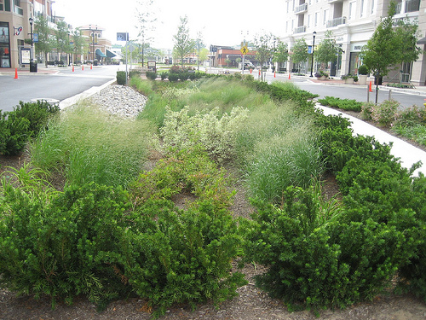
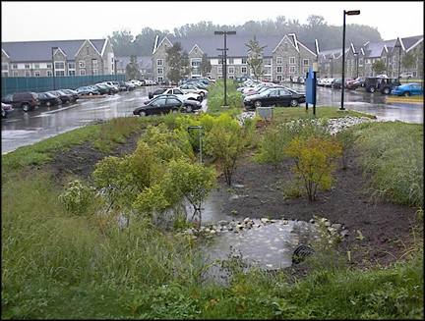
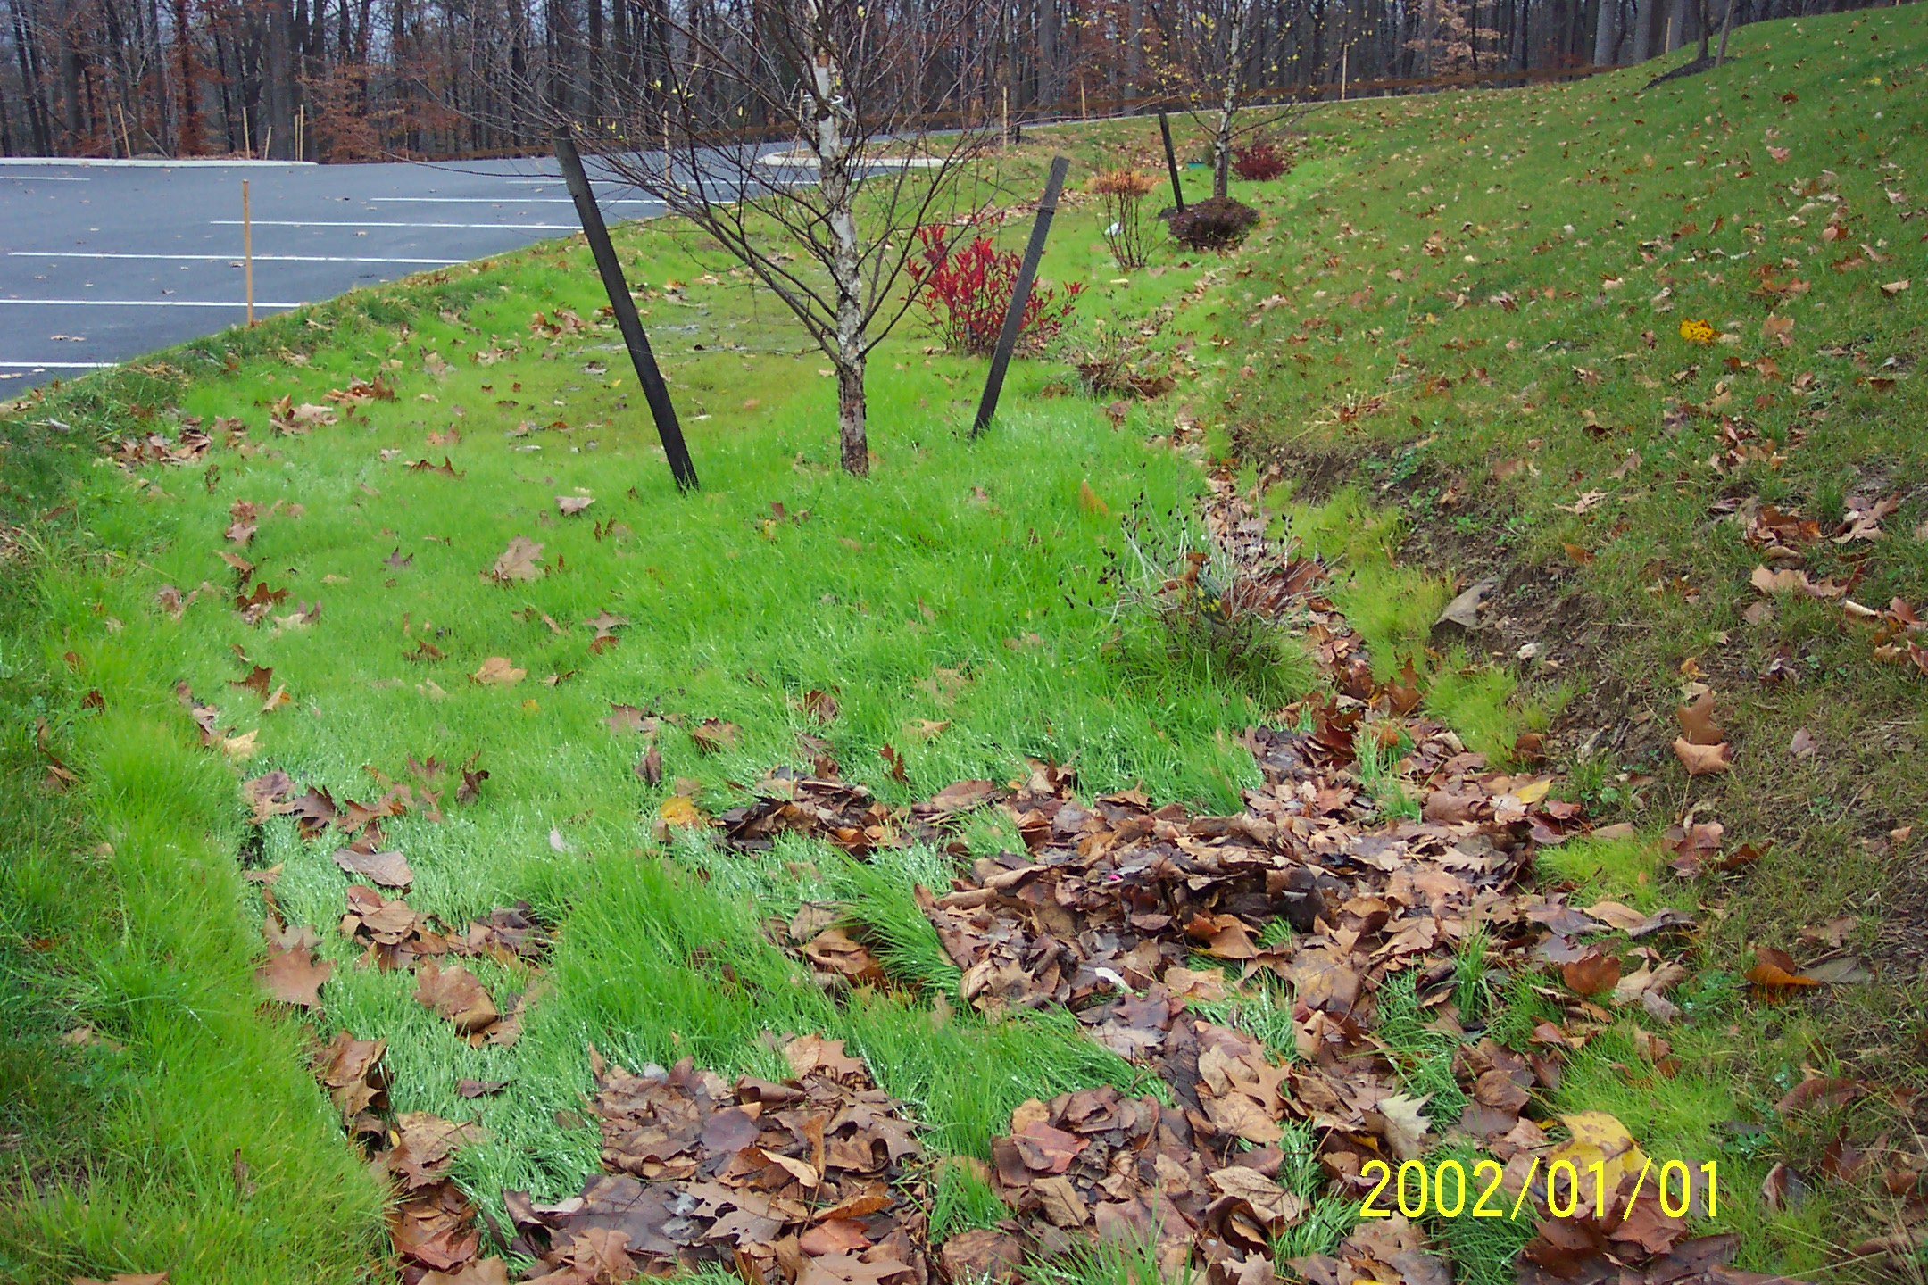
Maintaining Green Stormwater Infrastructure Systems
Sustaining green stormwater infrastructure through proper landscape management
Spring and Summer Maintenance
Emma Melvin
Regional Project Manager
Notes:
The goal of Green stormwater infrastructure is to manage stormwater through practices integrated into the urban landscape. Two types of systems make up green stormwater infrastructure, wet and dry systems. Dry systems- as implied are dry the majority of time, except for a immediately after a rain event. Wet systems remain water logged for long periods of time. Dry systems include- porous pavement, green roofs, and bio-retention systems. Bio-retention systems are the most commonly used practices and will be the focus of these trainings. They include rain gardens, tree trenches, and bio-swales. Maintenance for all the dry systems are similar, manage sediment, avoid clogging and ensure proper drainage.

Slide 3
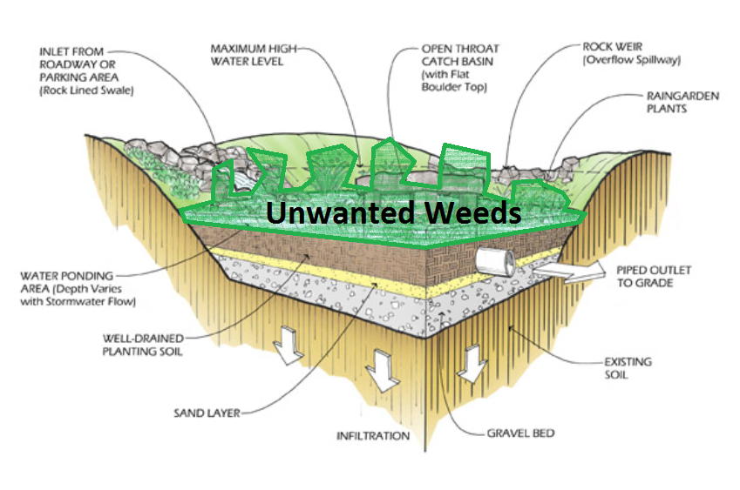
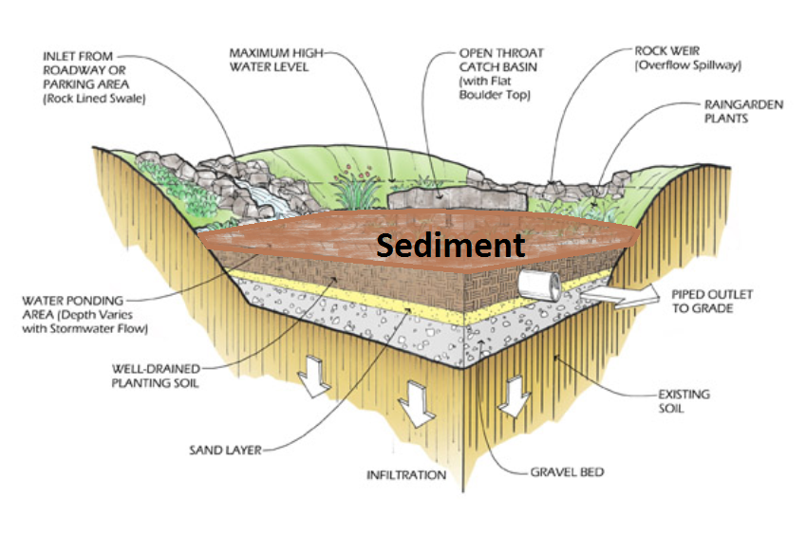
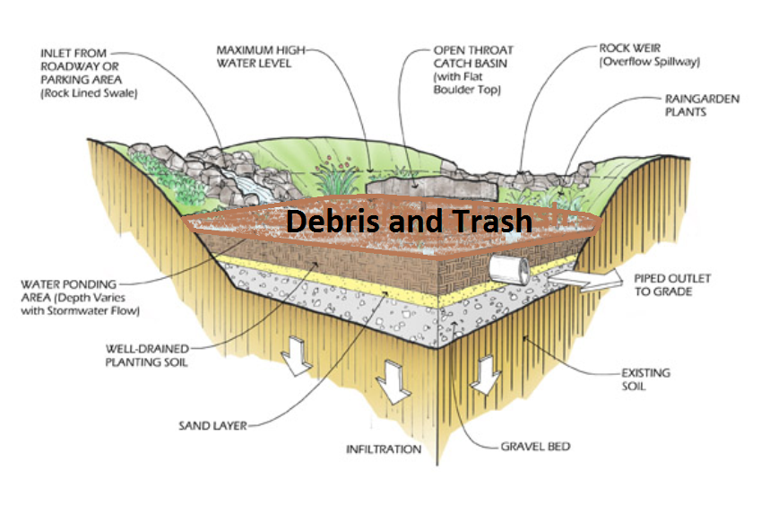
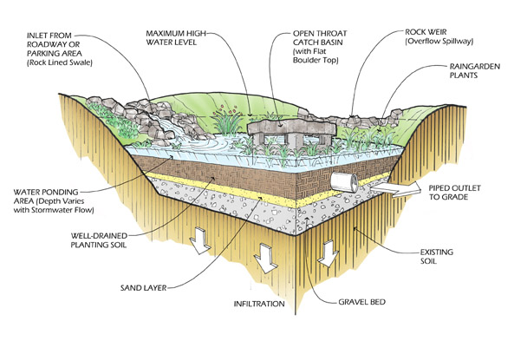
Bio-Retention Systems
Notes:
Bio-retention systems are commonly called rain gardens- which is used to describe the most common form of bio-retention with one or multiple recessed planting beds that receive stormwater. Other practices include bio-swales, swales densely planted, with a series of berms or check dams that hold and slowly move water through the swale to absorb and treat stormwater. Tree Trenches are also another form of bio-retention systems, using trees as the main vegetation, with a sandy soil trench extending from one tree pit to the next, gravel storage underneath with limited ponding at the surface of the tree pit.
This is a drawing of a bio-retention system commonly called a rain garden. All systems have 3 main parts.
Components of the system-
inlet/entrance- where water enters the system. Can include any combination of pipes, swale, forebay or stormdrains, curb cut or sheet flow in
Planting bed- a recessed planting area that detains water, allows materials in the water to settle out and water to absorb into the ground. Will include porous soil (the powerhouse of the system), mulch (the first line of defense) and plants, may include underdrains beneath the soil medium.
Outlet/exit- where the water leaves the system after the water reached the designed ponding depth. There are typically two outlets: an in-bed outlet made up of riser pipe and cover and an overflow which is a depressed area in the berm/top edge of the system that directs water out of the system to a designated area.
Stormwater carries with it all the things it picks up along its journey to the system including sediment, debris, trash and plant seeds. When systems are not maintained or overwhelmed by the excess material, this build up may cause the impairment to the systems functioning. Including burying the plants, clogging the soil pores and obstructing the entrance and the exit of the system. In addition weeds and other unwanted plants may crowd out the other plants originally planted.

Slide 4
Maintenance on entrances/inlets
Problems: | Solutions :
Erosion | Add stones at the top of the entrance
Sedimentation/clogging | Create a forebay at the bottom of the entrance Clear sediment or debris from pipes, culverts and swales at every visit
Gullying | Dense planting or additional stone
Water bypassing entrance | Clear entrance of sediment, grass or debris
Notes:
Each component of the system will have unique maintenance issues. When maintaining a site, always check the inlets and outlets before you start work within the planting bed. Ensure that water is able to enter the bio-retention system unobstructed. Maintenance issues for the inlets will include clogging at the entrance of the inlet with sediment, leaf litter, and trash. If this occurs water will bypass the system and can cause erosion at the inlet if there is limited flow space in the pipes causing the erosion at the exit of the inlet. When you have an open swale either soft surface-vegetated or hard surface such as a paved or rock lined erosion can occur if the water is entering to quickly or if part of the entrance is clogged. Either of these situations can cause gullying or plant die-back in a soft surface swale and can cause gullying and plant die-back in the planting bed in a hard surface swale.

Slide 5
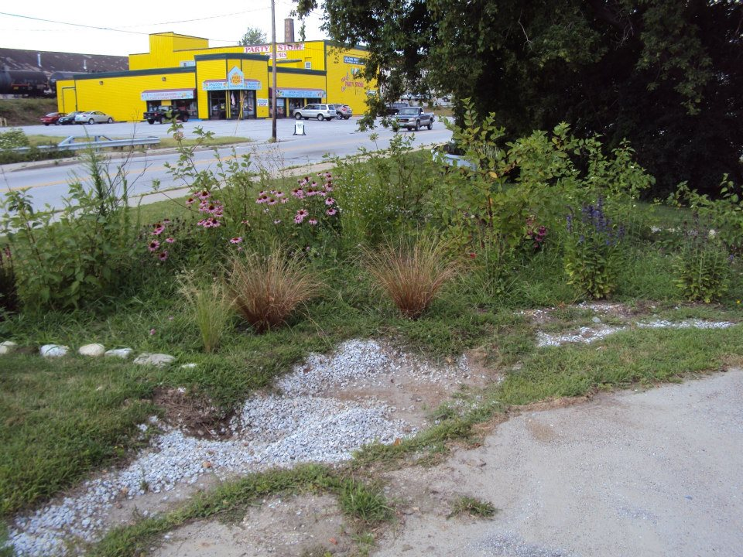
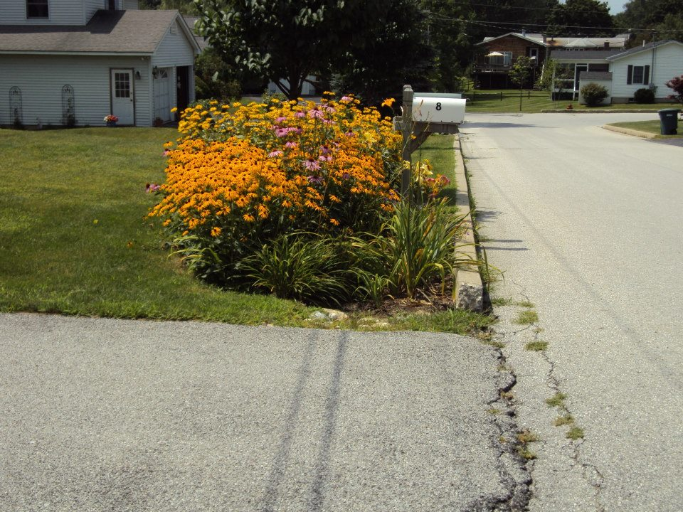
Things clogging entrance
Grass blocking entrance
Sediment and grass blocking the water flow into the garden
Notes:
As stormwater enters these systems through the inlet, it slows down and drops materials it was carrying. This includes road gravel, sediment, and seeds. Floatable items like bottles and other trash usually stay in suspension until the water enters the planting bed and starts to drain. These images show various issues that occur when the sediment drops out at the top of the inlet. Sediment can cause the entrance to be clogged or blocked, only allowing limited amount of stormwater to enter the system or to totally divert the stormwater from entering the system.

Slide 6
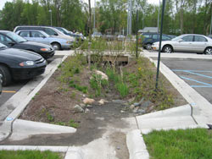
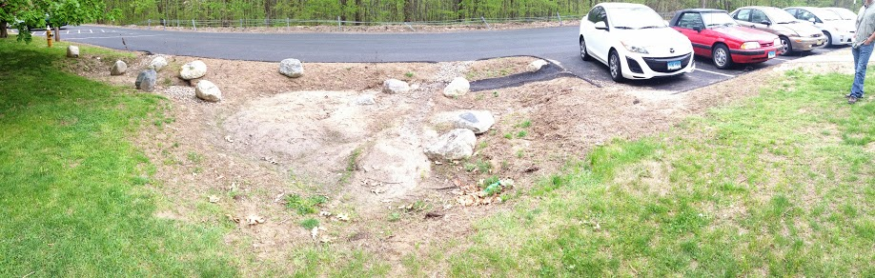
Sediment flowing into garden with water
Sediment entering the garden
Sediment in the garden
Notes:
Sediment can also drop out within the inlet and planting bed. It can smother the plants within a vegetated swale, can block the water from entering the system or can cause erosion at the top of the planting bed. If the sediment entering the garden is repeatedly smothering the vegetation of the planting bed, or if the system is installed in a high sediment area, a forbay can be installed at the end of the inlet, with a small ponding area and a low check dam. This allows easy sediment removal and cleaning compared to the task of removing sediment from the planting bed.

Slide 7
Maintenance on exit/outlets
Problems: | Solutions :
Erosion | Add stones around the outlet inside the bed and at the bottom of exit for the overflow
Clogging | Clear sediment or debris from rise pipe grate and swales at every visit
Gullying | Dense planting or additional stone
Notes:
Maintenance issues that can arise with outlets include the same issues are the inlets. They can become clogged with sediment, leaf litter and trash. Water can get stuck inside the system causing soil saturation in the planting bed. Clogging can also lead to erosion around the outlet structure. Both of these situation can lead to plant die back. During all storms mulch can be moved around the planting bed, in large storms mulch can be carried out of the planting bed.

Slide 8
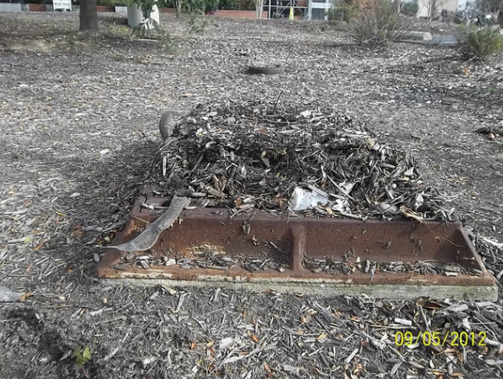
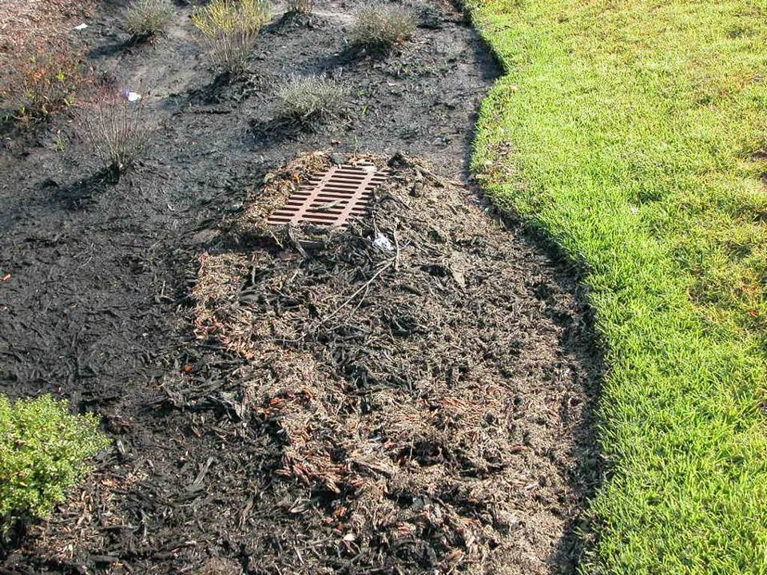
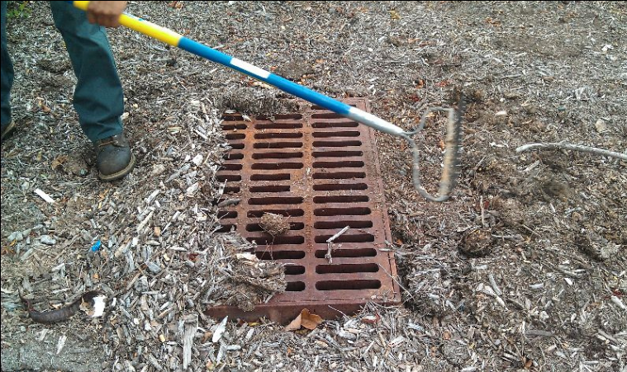
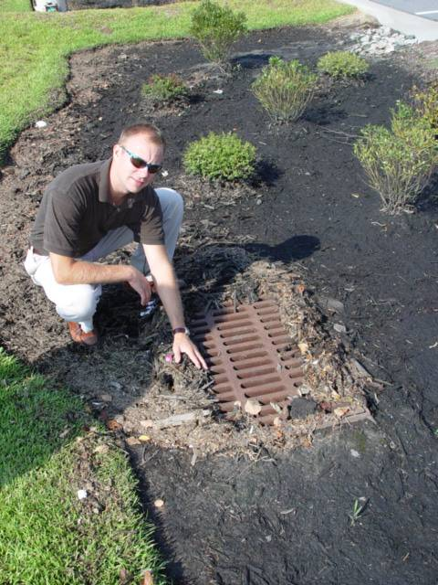
Removing debris from outlet
Notes:
As stormwater enters the planting bed it will drop out sediment but it will also pick up and move floatables, including mulch. Water will push mulch with it as it reaches the outlet/exit. As the water ponds and drains into the soil and overflows into the outlet, the floatables and other material it is carrying will drop out and pile up by the top of the outlet.
The mulch protects the soil from excessive drying out and actually removes pollution from the stormwater. It is important that part of maintenace includes the replacing of moved mulch back throughout the planting bed and adding mulch only when necessary. Adding mulch at every visit will cause a build up of mulch in the planting bed and can smother plants under the mulch. It will also end up filling up the recessed planting bed, leading to a reduced ponding area.

Slide 9
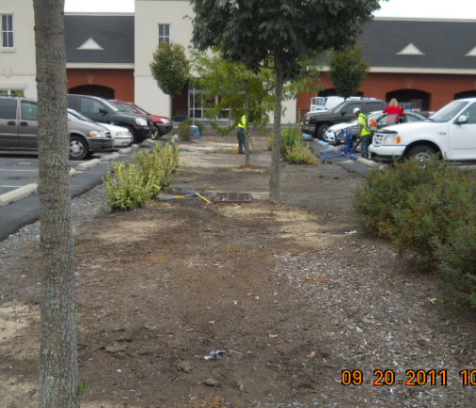
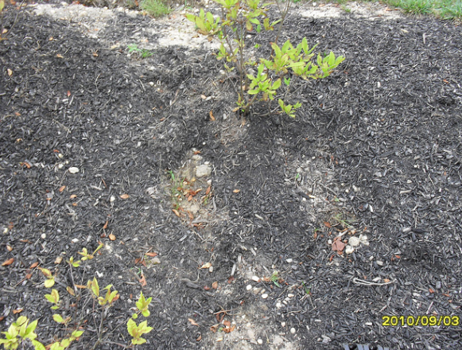
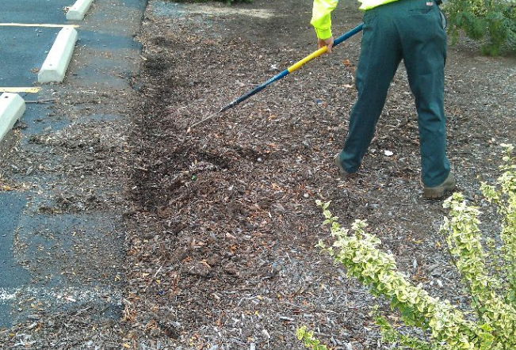
Mulch in the Garden
Raking mulch back in place
Replacing mulch
Notes:
During a large storm, mulch can be washed out of the planting bed as the water leaves the system, washed off the sloped areas in the planting bed, or it can be lost and need to be totally replaced.

Slide 10
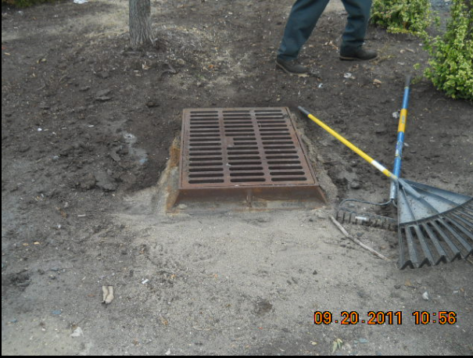
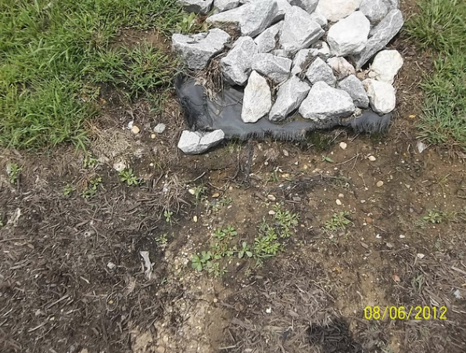
Erosion
Notes:
As the water enters the planting bed from the entrance, or leaves the planting bed at a slope, it can erode soil from the exposed slope. Rocks can be added to the bottom of the entrance or exit into the planting bed to disperse the water at a level portion of the bed.

Slide 11
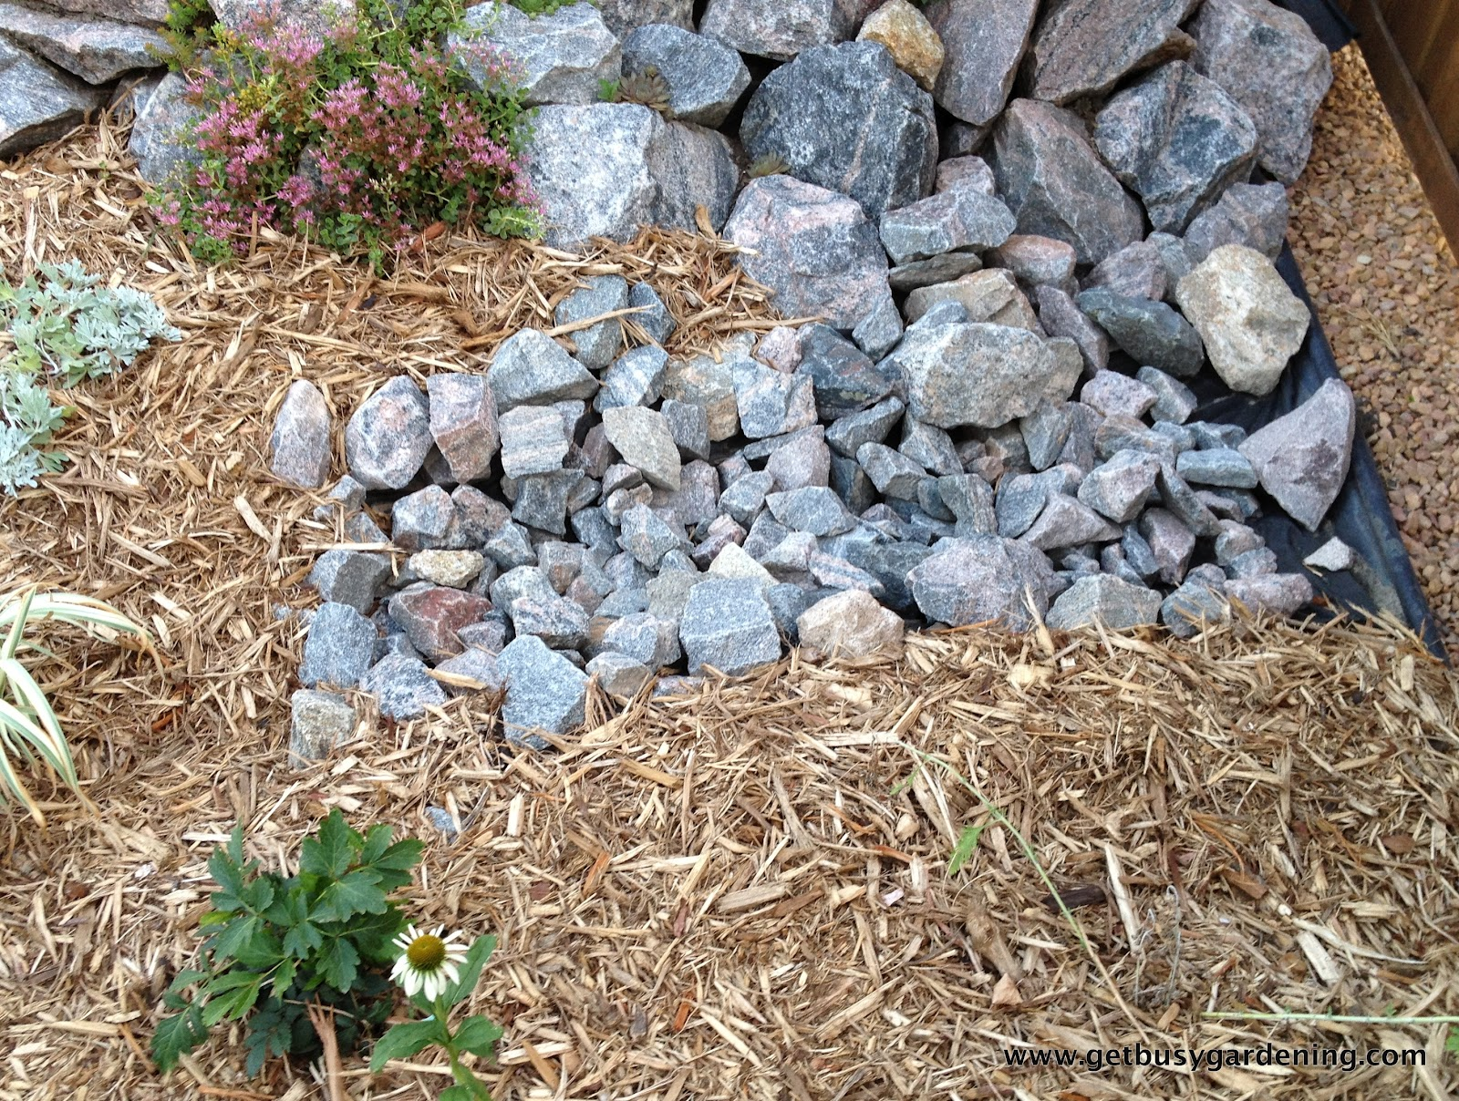
Adding stone around entrance and exit
Notes:
As water enters the system, large rocks should be placed at the top of the entrance and along the sides of a open swale to disperse and slow stormwater and capture sediment, smaller rocks can be extended into the swale to direct water and protect against gullying. Similar rock formation can be created at the outlet of the system- around a culvert/stormdrain within the planting bed.

Slide 12
Maintenance in planting beds
Problems: | Solutions :
Erosion | Add stones at the bottom of the entrance and around the outlet
Sedimentation/clogging | Create a forebay at the bottom of the entrance. Clear sediment or debris from pipes, culverts and swales
Gullying | Create check dams to slow water
Too much water entering the system | Create berm around planting bed and swale to limit the water entering the system
Plant die back | Clear debris from outlet to ensure water is not getting stuck in planting bed and replace plants
Notes:
It is important to assess the movement of water through the system, how it enters the planting bed, how long it ponds in the planting bed and how it exits the planting bed. Long durations of ponding can led to a series of complications in the plantings bed, including soil saturation, plant die back, soil compaction. These systems are designed to drain quickly, ponding after a normal storm for no more than a day or two at longest. If ponding last longing than this, it will lead to changes both in the soil biology and soil porousity. When soils are saturated with water for long periods of time, the soil microbes that live in a oxygenated soil environment die (well drained soils in a bioretetnion system) and are replaced by microbes that live in a anoxic or anaerobic (without oxygen) common in a wetland system. Too much water or sediment entering the system can be the cause of ponding water. Soil compact can be another cause of ponding water, this can have occurred at installation, during maintenance or due to long periods of ponding water. All these issues will lead to plant die back that can also lead to soil erosion and gullying.

Slide 13
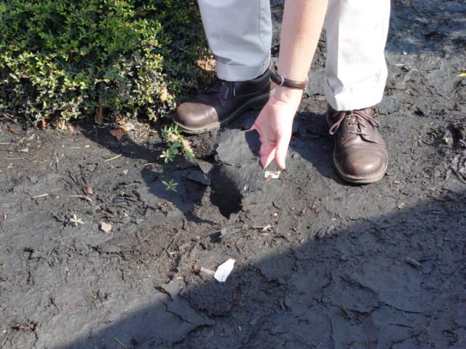
Sediment caked over the planting bed
Notes:
Stormwater can carry in excessive sediment that does not get integrated into the soil but smothers the mulch and cakes over into an impenetrable layer which water can not pass through. If not broken up or removed, plants will die and soil will become compact with the pressure of standing water.

Slide 14
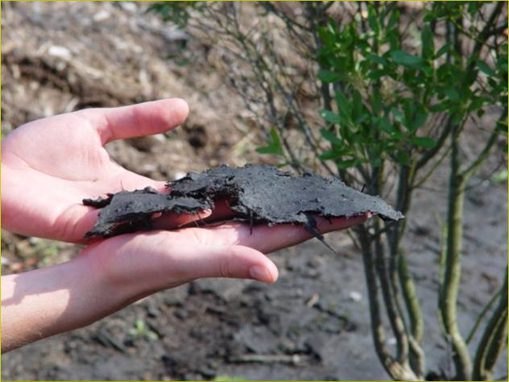
Matted mulch and sediment removal
Notes:
Maintenance would include scrapping off the excessive sediment, breaking up the caked matted mulch, and turning the mulch. If mulch is unsalvageable, it should be removed and replaced.

Slide 15
Sedimentation and adding a forebay
Notes:
If sediment is an issue inside the garden causing dead zones and clogging and requiring extensive maintenance, a forebay can be added to the bottom of the entrance to pond the stormwater exiting the inlet and allowing the sediment to drop out of the water prior to entering the planting bed. This forebay can be cleared seasonally to remove accumulated sediment.

Slide 16
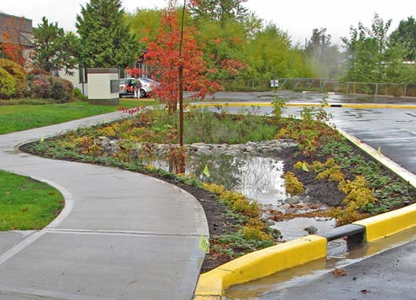
Creating a check dam
Notes:
If stormwater enters the system at high rates, check dams can be added to the entrance and the planting bed to slow the flow of water as it passes through the system. Check dams can also be added if the planting bed becomes sloped causing limited ponding throughout the planting bed. The check dam will create additional ponding areas.

Slide 17
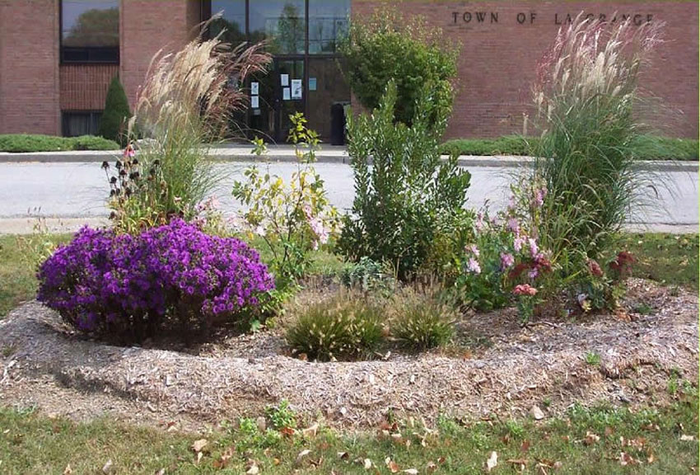
Creating a berm
Notes:
A berm is just a mounded area surround the bio-retention partially or completely. IT can be made of compacted soil, rock logs or any other material to hold water in the system. If additional water is entering the system from the adjacent lands that was not planned for a berm can be installed to redirect this water away from the planting bed, avoiding excess water ponding in the planting bed.

Slide 18
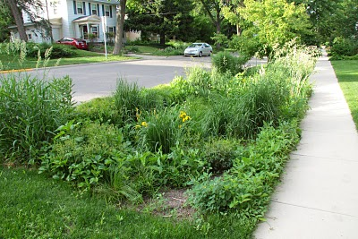
Weeds and invasive plants
Notes:
This completes our overview of Spring and summer maintenance, our next session will be on Weeds and Invasive Plants.

Slide 19
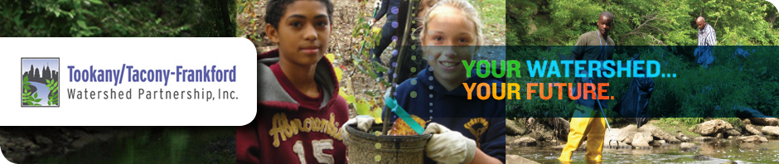




THANK YOU TO OUR
FUNDER & PARTNERS

